Slide 1


Migrate. Innovate. Enable
Unlock the full power of Azure
Company Profile
Website: www.snp.com
Contact Email: sales@snp.com

Slide 2

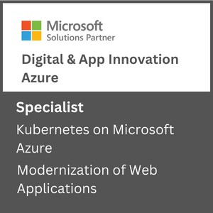
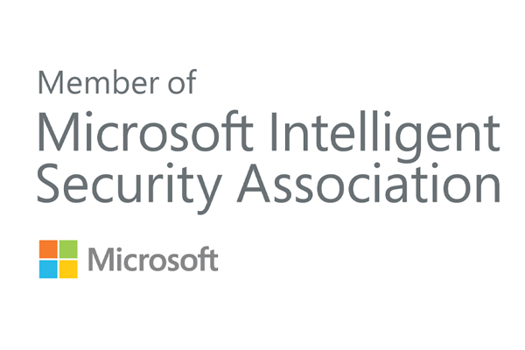
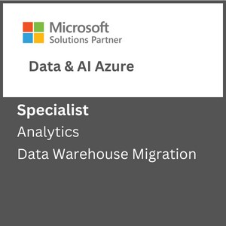
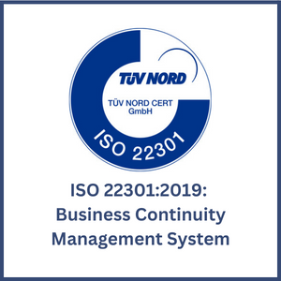
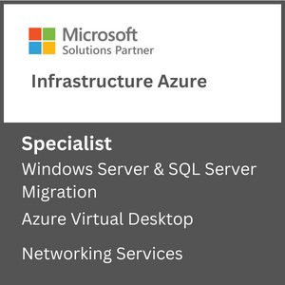
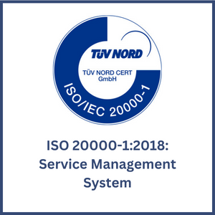

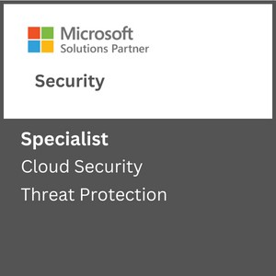
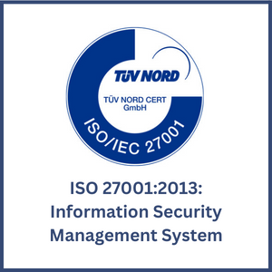

About SNP
Driving Innovation & Business Excellence with Microsoft Azure in:
SNP transforms businesses with innovative, cloud-based solutions that harness the power of Microsoft Azure. We are 100% Azure focused, 100% SMC focused and 100% certified for different Microsoft funding programs like ECIF, Azure Innovate and AMM.
SECURITY
Defend Against Threats with SIEM Plus XDR
Secure Multi Cloud Environments
Secure Identities and Access
Protect and Govern Sensitive Data
Mitigate Compliance and Privacy Risks
DevSec Ops
MICROSOFT ADVANCED
SPECIALIZATIONS
APPS & INFRASTRUCTURE
Migrate and Modernize Your Infrastructure and Workloads - WS/SQL on Azure; Linux/OSS DB on Azure; AVS; AVD
Protect Your Data and Ensure Business Resiliency with BCDR- Azure Backup, Azure Site Recovery, BCDR Solutions
ANALYTICS ON MICROSOFT AZURE
NETWORKING SERVICES
AZURE VIRTUAL DESKTOPS
KUBERNETES ON MICROSOFT AZURE
Migrate enterprise apps to Microsoft azure
INFRA & DATABASE MIGRATION TO MICROSOFT AZURE
CLOUD SECURITY
THREAT PROTECTION
DATA WAREHOUSE MIGRATION
Modernize Your Workloads with Azure at any Scale with HPC plus AI- Azure specialized VMs, Azure Cycle/Batch, Storage Services, Networking Services.
Innovate Across Hybrid and Edge with Azure Arc- Azure Arc, Arc-enabled data and ML, AKS, Microsoft Defender, Azure Monitor ,Azure Stack HCI
ISO Certifications:
DevOps on Azure: DevOps Maturity Model, CI/CD, IaaC, DevSecOps
DATA, ANALYTICS & AI
Innovate with AI and Cloud Scale Databases in Every App- Azure Cognitive Services, Azure Applied AI Services, Azure Cosmos DB, Azure MySQL & PostgreSQL, Azure SQL DB, Azure ML
Migrate and Modernize Your Data Estate- Azure SQL MI, Azure SQL IaaS, Azure Arc Data, Azure Cosmos DB, Azure PostgreSQL​, Azure MySQL
MICROSOFT PARTNER AWARDS
Power Business Decisions with Cloud Scale Analytics- Azure Synapse, Azure ML, Azure Databricks & PBI
Enable Unified Data Governance- With Microsoft Purview get unified data governance across on-premises, multi-cloud, and SaaS environments
DIGITAL & APPLICATION INNOVATION
2023 PARTNER OF THE YEAR
FINALIST
Security
Modernize Enterprise Applications- Azure App Service , Azure Spring Cloud, API Management, Logic Apps, Power Apps, AKS
Innovate and Scale with Cloud Native Apps - AKS, Azure Functions, Azure Container Apps, Azure DB for PostgreSQL, Azure Cosmos DB, Azure Arc
2021 MSUS PARTNER OF THE YEAR WINNER
Business Excellence in Solution Assessments
Enable Developer Productivity and Accelerate Delivery- Power Apps, Power Automate
Accelerate Innovation with Low Code- GitHub, Visual Studio
AZURE MANAGED SERVICES
2019 MSUS PARTNER OF THE YEAR WINNER
Intelligent Cloud & OSS on Azure
Support Desk Operations
Managed Azure Infrastructure Operations
Managed Security Operations
Managed App Services and Kubernetes.
Optimization Services
Managed DR & Backup Operations
Managed Data Operations
Managed DevOps Services
2019 PARTNER OF THE YEAR FINALIST
Open-Source Applications & Infrastructure on Azure
CSP SERVICES
Licensing Support
Azure Billing Support
Azure Service Health Support
FinOps as an Add on Support

Slide 3
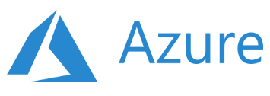
Key Focus Areas
Recent Projects
Artificial Intelligence & Machine Learning
Data Engineering Services
Database Modernization
MLOps
Solution Architecture & Consulting Services
Business Intelligence & Visualization Services
Power Bi with Synapse Analytics
Data Platform in 30 Days
Data Integration Services
Enterprise DW Modernization
Data Integration Services
ML Model Building & Consulting
ML Platform Operationalization (MLOps)
SQL Server Modernization with Azure PaaS
Power BI Governance
Power BI Development
Data, AI & Analytics
Migrate and transform data for data driven customers using solutions such as data engineering, BI and AI
Apps & Infrastructure
Hybrid Cloud
Hybrid Security Rationalization & Strategy
Cloud Infrastructure & Management
Hybrid Cloud Strategy with Azure Arc
App Innovation
DevOps & GitOps Solutions
Open-Source Solutions
Hybrid Identity
API Management
Infrastructure Rationalization & Migration Roadmap design
Servers Lift & Shift
OSS & SQL Migration to PaaS
Citrix Virtual Desktops
Windows Virtual Desktops
Hybrid Cloud Framework
Hybrid Management with Azure Arc
Compliance Policy as a Code
Hybrid Security Rationalization
.NET – Application Modernization with Azure PaaS
OSS - Application Modernization with Containers & Azure PaaS
AKS Maturity Model
Kubernetes & Containers
Red Hat Cloud Solutions
DR & Cloud Failover
Azure Sentinel & SIEM Integration
Azure Sentinel - Workflow & Connectors development
End-to-end cloud solutions which include infrastructure and operations, DevOps and automation and application modernization
Azure Managed Services
CSP Hosting Services
Support Desk Operations
Managed Azure Infrastructure Operations
Managed Disaster Recovery & Backup Operations
Virtual Desktop Infrastructure –(VDI) Operations
Managed Data Platform Operations
Managed DevOps Services
Managed Security Operations
Managed VDI Operations (Citrix & Windows VDI)
Premium Managed Services
Azure Managed Services supporting the full Microsoft Azure solution suite including infrastructure, data, security, DevOps and more
Industries We Serve
Healthcare
Biotech
Financial Services
Manufacturing
Professional Services
Engineering & Architecture

Slide 4
Key Focus Areas
Recent Projects
Artificial Intelligence & Machine Learning
Data Engineering Services
Database Modernization
MLOps
Solution Architecture & Consulting Services
Business Intelligence & Visualization Services
Power Bi with Synapse Analytics
Data Platform in 30 Days
Data Integration Services
Enterprise DW Modernization
Data Integration Services
ML Model Building & Consulting
ML Platform Operationalization (MLOps)
SQL Server Modernization with Azure PaaS
Power BI Governance
Power BI Development
Data, AI & Analytics
Migrate and transform data for data driven customers using solutions such as data engineering, BI and AI
Apps & Infrastructure
Hybrid Cloud
Hybrid Security Rationalization & Strategy
Cloud Infrastructure & Management
Hybrid Cloud Strategy with Azure Arc
App Innovation
DevOps & GitOps Solutions
Open-Source Solutions
Hybrid Identity
API Management
Infrastructure Rationalization & Migration Roadmap design
Servers Lift & Shift
OSS & SQL Migration to PaaS
Citrix Virtual Desktops
Windows Virtual Desktops
Hybrid Cloud Framework
Hybrid Management with Azure Arc
Compliance Policy as a Code
Hybrid Security Rationalization
.NET – Application Modernization with Azure PaaS
OSS - Application Modernization with Containers & Azure PaaS
AKS Maturity Model
Kubernetes & Containers
Red Hat Cloud Solutions
DR & Cloud Failover
Azure Sentinel & SIEM Integration
Azure Sentinel - Workflow & Connectors development
End-to-end cloud solutions which include infrastructure and operations, DevOps and automation and application modernization
Azure Managed Services
CSP Hosting Services
Support Desk Operations
Managed Azure Infrastructure Operations
Managed Disaster Recovery & Backup Operations
Virtual Desktop Infrastructure –(VDI) Operations
Managed Data Platform Operations
Managed DevOps Services
Managed Security Operations
Managed VDI Operations (Citrix & Windows VDI)
Premium Managed Services
Azure Managed Services supporting the full Microsoft Azure solution suite including infrastructure, data, security, DevOps and more
Industries We Serve
Healthcare
Biotech
Financial Services
Manufacturing
Professional Services
Engineering & Architecture

Slide 5
Defender for Cloud
KONYALA DATHA SAI CHANDU​

Slide 6
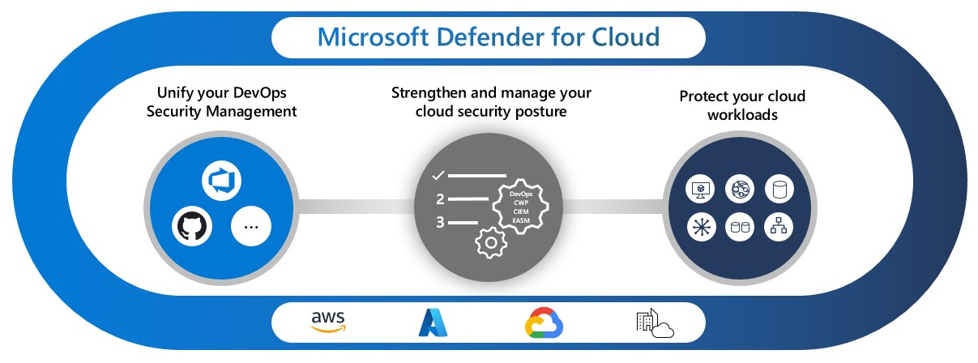
Defender for cloud
Azure defender is designed to protect cloud-based application from cyber threats and vulnerabilities.
Microsoft 365 Defender provides an overview of attacks, including suspicious and malicious events that occur in cloud environments.
6

Slide 7
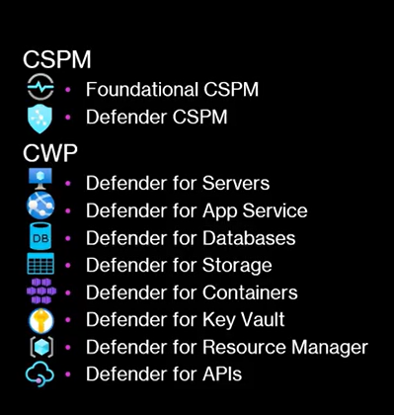
CSPM and CWPP
CSPM gives the recommendations in a proactive way and preventative way before anything bad happens.
CWPP deals with runtime protection for various resources and deals with actual threats.
7

Slide 8
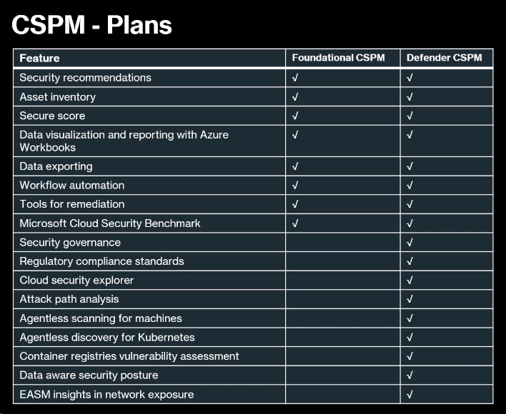
Defender Pricing

Slide 9
Foundational CSPM Features

Slide 10
Inventory
The inventory is a place where you can get to know the resources which are:
Total number of resources
Number of Unhealthy resources
Number of Healthy resources
Unmonitored resources
From the inventory, you can know whether you have a monitoring agent on a particular resource or not.
We can use KQL (Kusto-Query-Language) to filter out

Slide 11
Security Recommendations
Recommendations in Defender for Cloud are based on the Microsoft cloud security benchmark.
The Microsoft Security Benchmark is the Microsoft authorized set of guidelines for security and compliance best practices.
Your secure score is based on the number of security recommendations you've completed.
Based on the severity, the recommendations are remediated.
The resource health is shown and the status of the recommendation is shown whether it is completed or not.
11

Slide 12
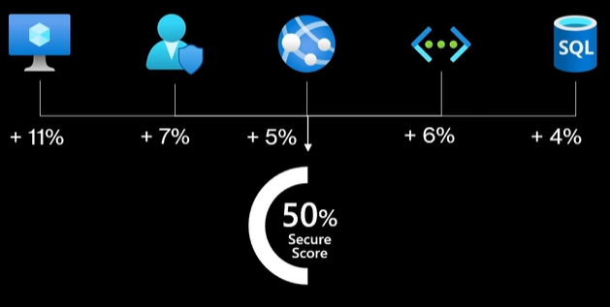
Secure Score
Entire purpose of Secure Score is to provide a number from 0 - 100, and this number tells you how secure you are for your various resources.
Rather than recommendations. The domains where you can remediate a set of recommendations to increase the secure score.
Also shows the max score and current score of a resource.
12

Slide 13
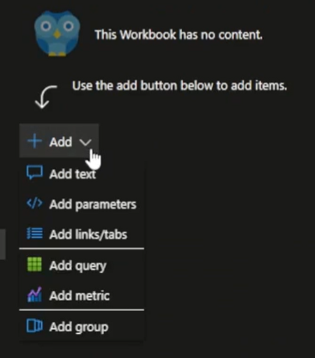
Workbooks
Workbooks are used to create dashboards and visualizations.
Workbooks can be created from the scratch using Kusto Query Language or add Metric option with interactive interface.
Templates are readily available to choose.
13

Slide 14
Data Exporting
Data Exporting is used to export alerts and recommendations or vulnerability to other 3rd party tools or sentinel and monitoring tools.
We can Export the data to an EventHub or another log-analytic workspace of different subscription.
The regulatory compliance, alerts and recommendations can be filtered out and sent based on severity.
The data Exporting also provides the feature of streaming the alerts and recommendations at real-time or specific snapshot.
14

Slide 15
Remediation
Remediation for a recommendation can be done in two ways.
Manual remediation.
Quick fix a recommendation (shows for few).
Using Quick fix option can introduce to a state so-called as “drift”.
If you don’t know the workload, it can heavily impact it by applying a fix Automatically.
There will be a period called Freshness period which will tale 30 minutes to remove the recommendation after you click on quick fix
15

Slide 16
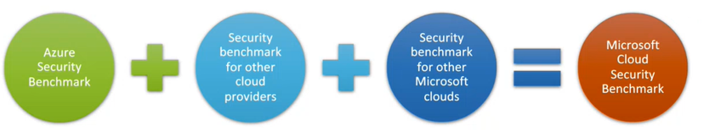
Microsoft Cloud Security Benchmark
16

Slide 17
The Azure Security benchmark is renamed to Microsoft Cloud Security benchmark.
Benchmark provides best practices and recommendations for your resources.
Lot of them are invented by Microsoft but. It also had a look at the most prominent industry benchmarks, like
CIS benchmarks
NIST
PCI
DSS
AWS well-Architected framework
17

Slide 18
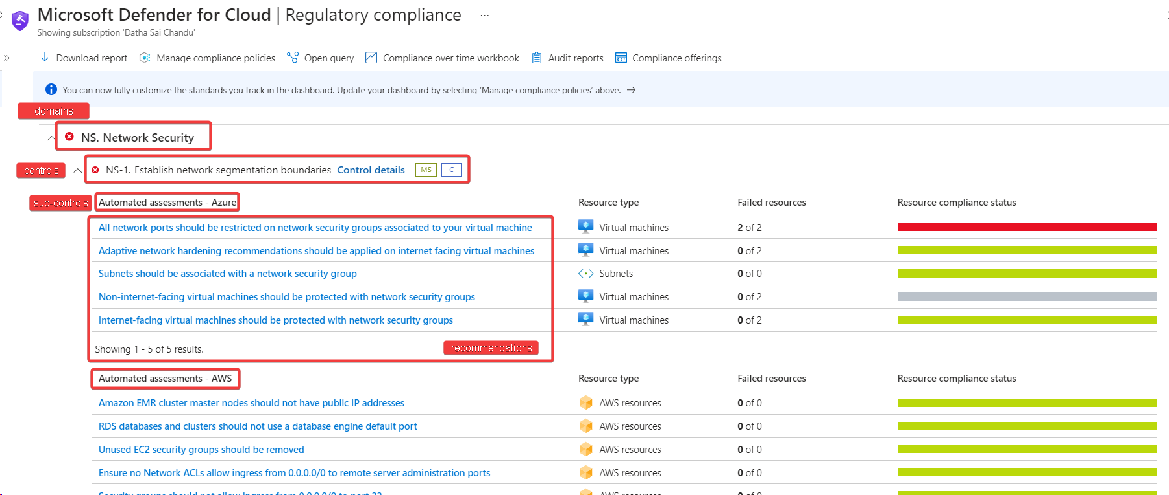
These domains have all the controls and these controls have sub-controls
18

Slide 19
Defender CSPM Features

Slide 20
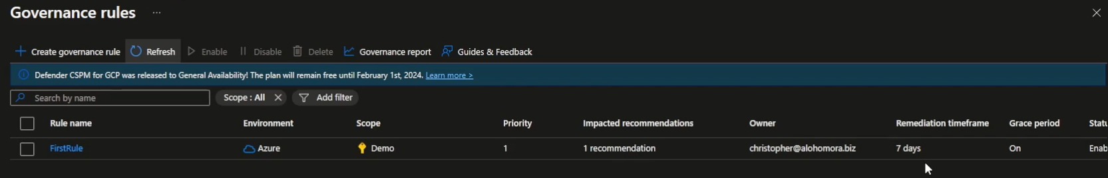
Governance rules
You can define rules that assign an owner and add a due date for Remediating a recommendation
Provides an SLA as you are adding a due date for a recommendation to be remediated.

Slide 21
Regulatory Compliance Standards
Defender for Cloud assesses your resources against popular frameworks and regulatory standards:
ISO
NIST
SOC
Microsoft Azure Foundations Benchmark
Hippa
It accesses your compliance and security posture based on the controls of certain frameworks.

Slide 22
Cloud Security graph
Graph-based context engine that exists within Defender for Cloud.
The cloud security graph collects data from your multicloud environment and other data sources.
For example, the cloud assets inventory, connections and lateral movement possibilities between resources, exposure to internet, permissions, network connections, vulnerabilities and more.
The data collected is then used to build a graph representing your multi-cloud environment.

Slide 23
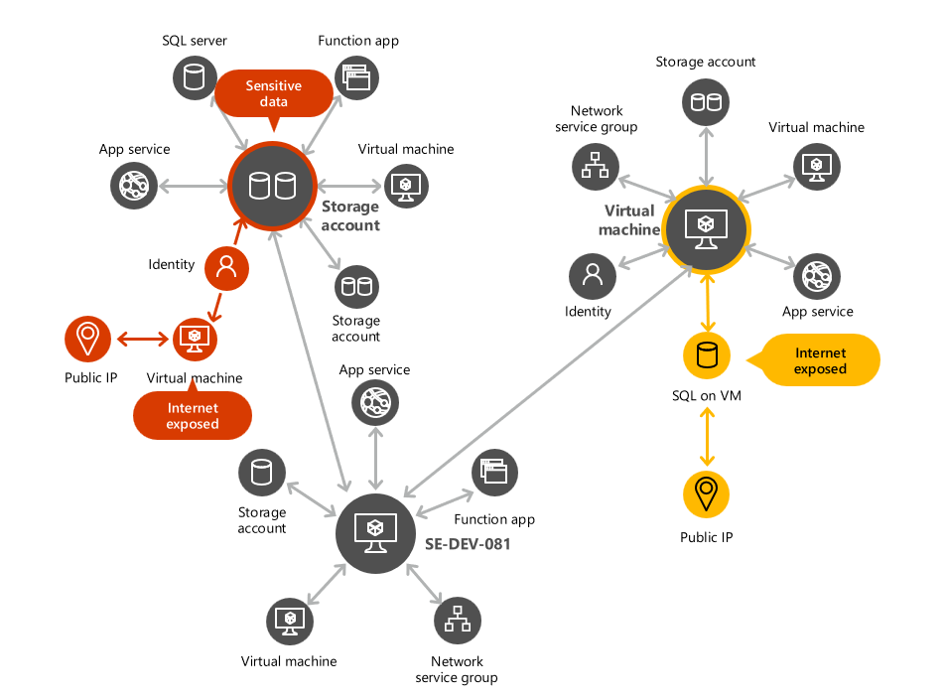
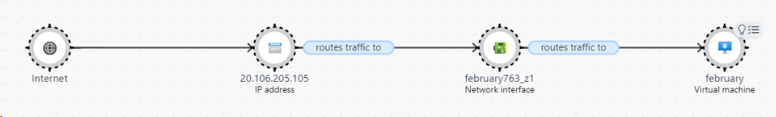
Defender for Cloud then uses the generated graph to perform an attack path analysis and find the issues with the highest risk that exist within your environment.

Slide 24
Attack Path Analysis
Attack path analysis is a graph-based algorithm that scans the cloud security Graph.
The scans expose exploitable paths that attackers might use to breach your environment
Suggests recommendations as to how best remediate issues that will break the attack path and prevent successful breach.
helps you to remediate the highest risk ones first.
Like:
VM containing critical vulnerabilities is exposed to the internet
VM containing critical vulnerabilities is exposed to the internet with read Permissions to a key vault
Azure Blob storage with sensitive data is publicly accessible

Slide 25
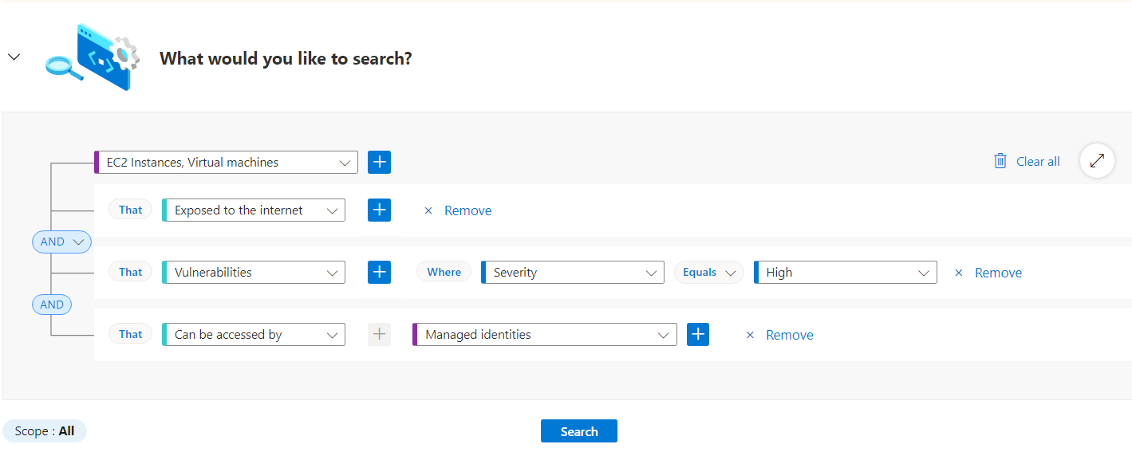
Cloud Security explorer
By running graph-based queries on the cloud security graph with the cloud security explorer, you can proactively identify security risks in your multi-cloud environments.
Cloud security explorer allows you to query resources and logs Without the need for writing KQL queries

Slide 26
Agentless Scanning in VM
Requires Defender CSPM or Defender for Servers Plan 2.
Also provides Zero Performance Impact.
Agentless scanning is a kind of scanning which is done on a snapshot of a disk, taken to a so-called Isolated Scanning Environment and scanned there.
The Vulnerability engine scans the snapshot of the disk and results of the scan are fetched out and sent to the Defender for cloud.

Slide 27
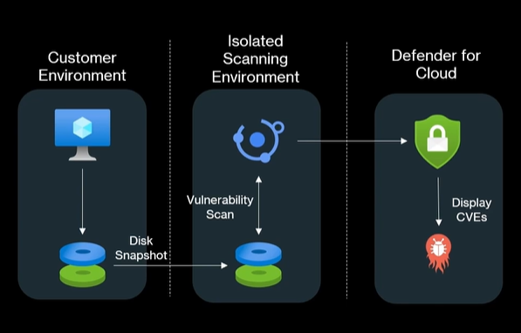

Slide 28
Workload Protection Plans
Servers
App Service
Databases
DB
Storage
Containers
Key Vault
Resource Manager
APIs

Slide 29
Defender for Servers
Microsoft Defender for Endpoint
Includes an automatic, native integration with Microsoft Defender for Endpoint.
Endpoint detection and response (EDR) features that are provided by Microsoft Defender for Endpoint.
Some of the features of MDE are
Attack surface reduction
Hardware isolation
Application control
Ransomware protection
Controlled folder access
Network protection
Web protection
Exploit protection
Device control

Slide 30
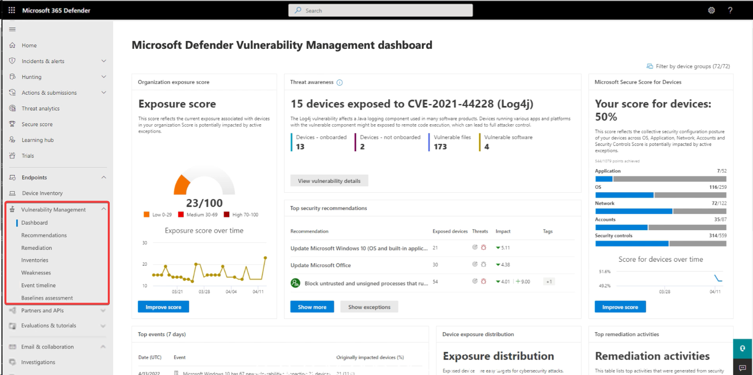
Microsoft Defender Vulnerability Management
Defender Vulnerability Management delivers asset visibility, intelligent assessments, and built-in remediation tools for Windows, macOS, Linux, Android, iOS, and network devices.
Remediate vulnerabilities and mis-configurations all in one place.
We can block vulnerable versions of applications

Slide 31
Adaptive Network Hardening
Adaptive network hardening provides recommendations to further harden the NSG rules.
Using all the information to understand what's normal and what's suspicious, and then recommends blocking any connections that seem risky.
The enforced rules are added to the NSG protecting the VM.
Modify rules
Cannot change an allow rule to become deny rule.
A Deny all traffic rule is the only type of "deny" rule that would be listed here, and it cannot be modified. You can, however, delete it.
Add a new rule
You can add an "allow" rule that was not recommended by Defender for Cloud.
Only "allow" rules can be added here. If you want to add "deny" rules, you can do so directly on the NSG.
Delete a rule
When necessary, you can delete a recommended rule for the current session.

Slide 32
File Integrity Monitor
Examines operating system files, Windows registries, application software, and Linux system files for changes that might indicate an attack.
FIM (file integrity monitoring) uses the Azure Change Tracking solution to track and identify changes in your environment.
When FIM is enabled, you have a Change Tracking resource of type Solution.
FIM informs you about suspicious activity such as:
File and registry key creation or removal
File modifications
Registry modifications

Slide 33
Defender for App service
Attackers probe web applications to find and exploit weaknesses.
Before being routed to specific environments, requests to applications running in Azure go through several gateways, where they're inspected and logged.
The data is then used to identify exploits and attackers, and to learn new patterns that are used later.
This service assesses the resources covered by your App Service plan and generates security recommendations based on its findings.
The detection can be done by monitoring.
The VM instance in which your App service is running and its management interface.
Requests and responses sent to and from your App service apps.
Underlying sandboxes and VMs
App service internal logs
The alerts generated by the service almost the complete list of MITRE ATTACK.

Slide 34
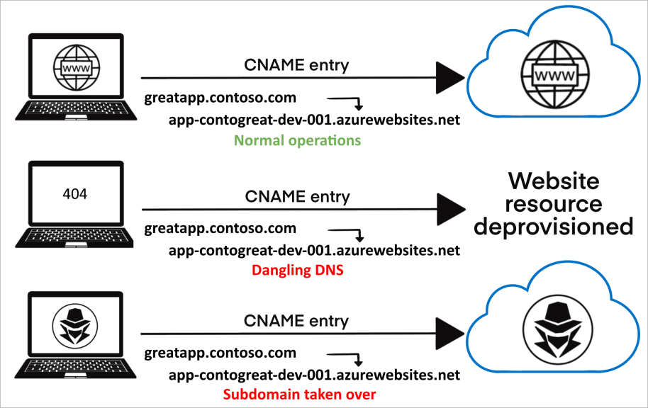
The Defender for App service also protects from domain takeovers by generating DNS dangling alerts.
Subdomain takeovers are a common, high-severity threat for organizations. When a threat actor detects a dangling DNS entry, they create their own site at the destination address.

Slide 35
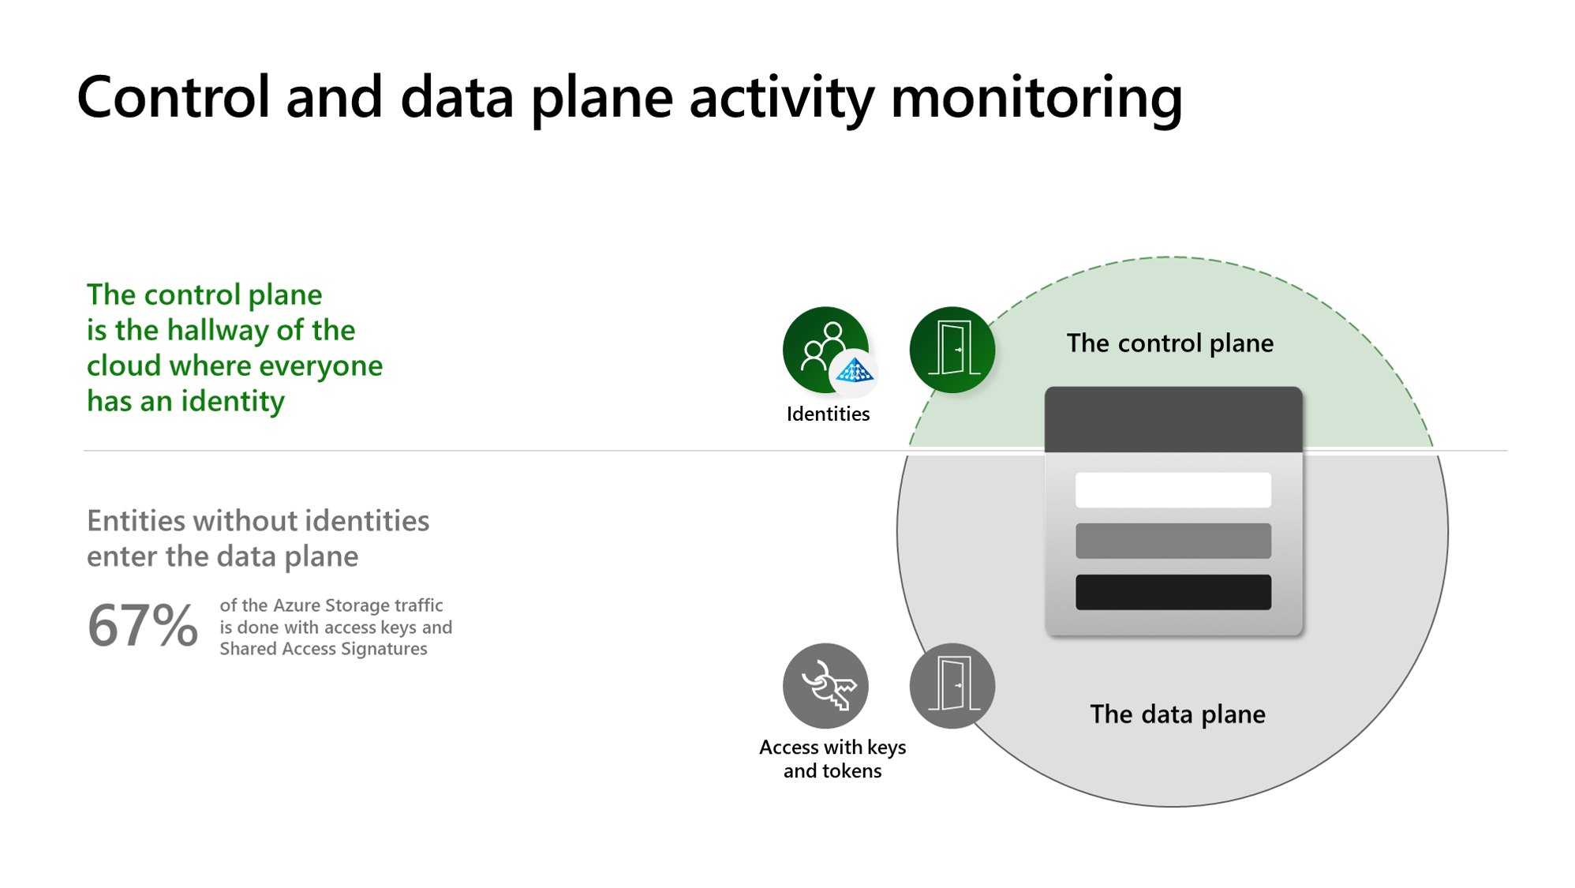
Defender for Storages
It helps prevent the three major impacts on your data and workload:
malicious file uploads,
sensitive data exfiltration,
Data corruption.
Microsoft Defender for Storage provides comprehensive security by analyzing the data plane and control plane telemetry
Defender for Storage includes:
Malware Scanning.
Sensitive data threat detection.

Slide 36
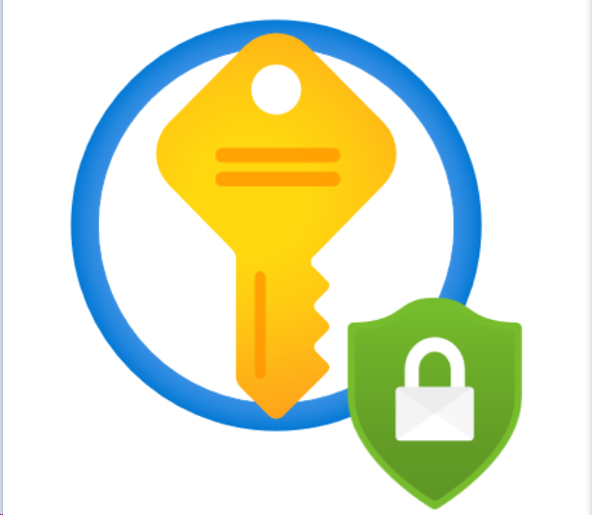
Defender for Key-vault
The azure key vault is used to store keys, Certificates and Secrets.
Detects unusual and potentially harmful attempts to access or exploit Key Vault accounts.
Key Vault shows alerts and optionally sends them via email to relevant members of your organization.
Recommend you investigate and respond to the alert as described below.
Identify the source.
Respond accordingly.
Measure the impact.
Take action.

Slide 37
Defender for Resource Manager

Slide 38



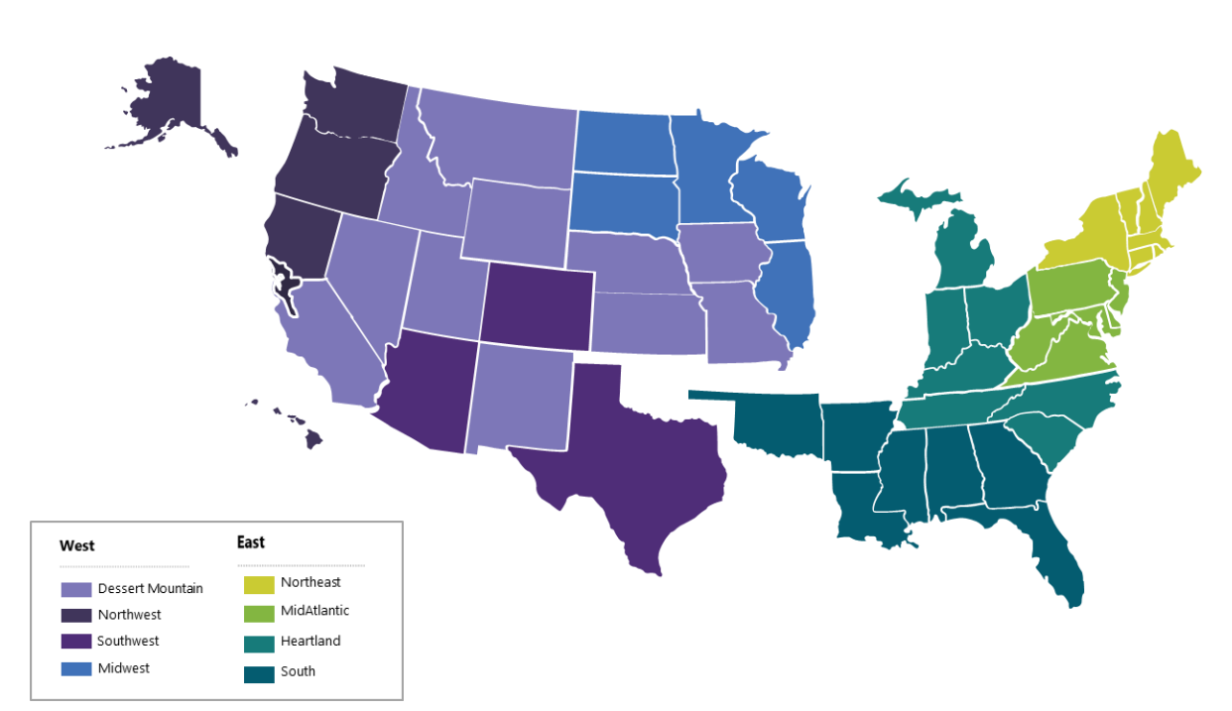

Contact Us:
Company Headquarters
SNP Technologies, 2319 Whitney Avenue, Suite 3C Hamden, CT 06518-3535,
(203) 287-9114
Sachin Parikh
VP of Business Development
sachin@snp.com
203-287-9114 X 112
Phil Balogh
Director Sales- North -USA
phil@snp.com
203-228-0310
Emerging/Investment
Market
Established
Market
Michael Fiorito
Director Sales- South- USA
Michael.fiorito@snp.com
917-753-0346
100% focused in SMC

Slide 39


www.snp.com
2319 Whitney Ave. | Suite 3C | Hamden, CT 06518

